Slide 1
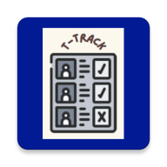
T-track App
An attendance marking App showing the count of number of classes a student has attended
Developer: Deepak Patil
Roll-number: 20C4022
Enrollment number: DE20113
Class- CS-A

Slide 2

Solution
Problem
VS
Thus , T-Track provides with the solution to this problem where the data is directly uploaded to the Database and No need to carry attendance sheets
Marking attendance is a very simple job but even in today’s world the solution is not there to effectively mark attendance and track it.
I have seen Teachers/professors Struggle in that process
They would first manually mark it in their attendance sheet and then upload it on database which is a very tedious and long job

Slide 3
App overview
Login
Show attendance
Register
Mark attendance
Class List
Registering student
Unique Id is provided to each teacher
Shows the list of students along with their present count
If account doesn't exist then user could create new account
By entering roll no. teacher could mark the attendance of specific student
The app provides with list of classes a teacher teaches in.
If roll no. doesn’t exist user must register student first

Slide 4
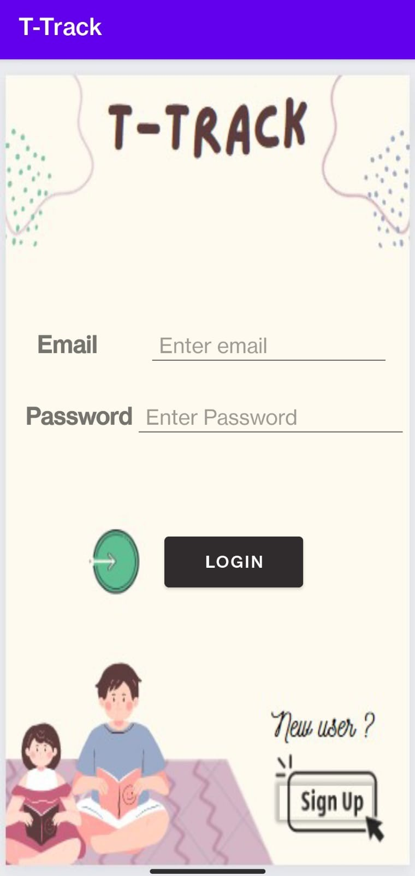
Working
Home Screen
Login Section
If User is already registered then he could login with the help of unique id and password by entering registered email and password and clicking on login button.The Authentication is done using Firebase Authentication
Signup
If User is not registered then he need to first register himself by clicking on Signup button

Slide 5
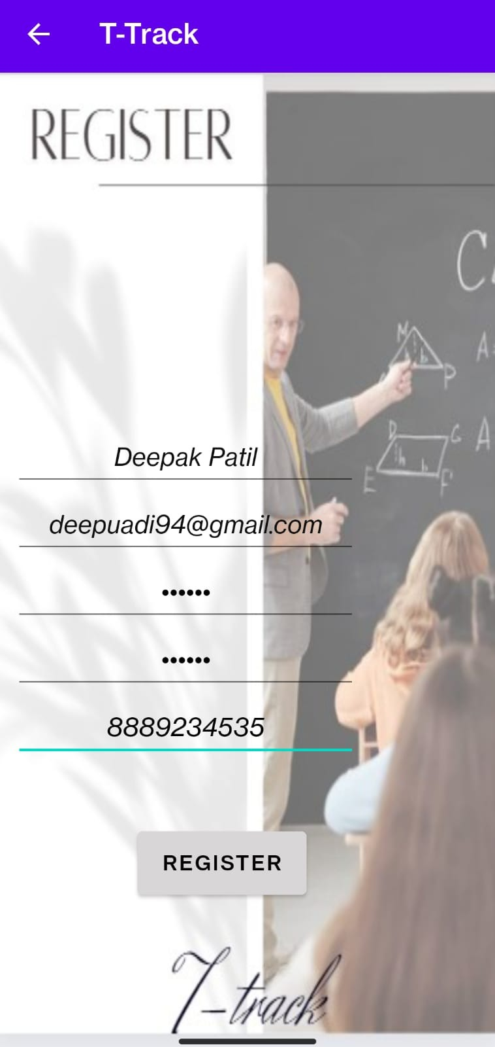
Working
Signup Screen
Registering user
If User is not registered then he need to first register himself by providing his details which include name,email id,password ,confirm password and Phone no.
User gets registered after pressing the register button and his data is stored in firebase which could be used for authentication.
Then intent is sent to login/Home screen

Slide 6
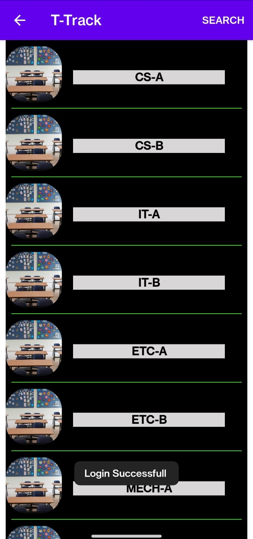
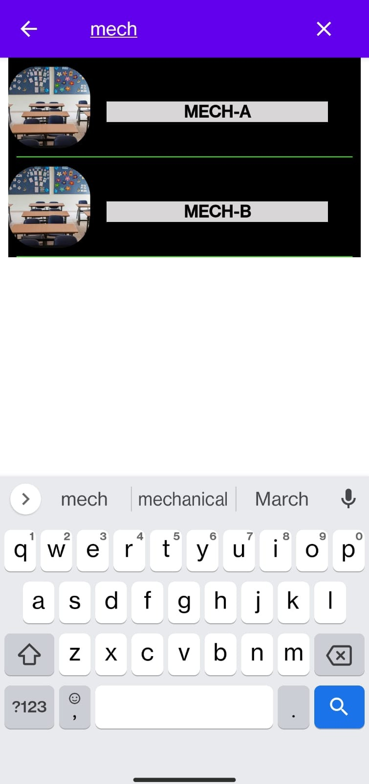
Working
Classes Screen
Searching class
The User is provided with list of classes with the help of recyclerview from which he could choose the class in which he needs to see or mark attendance
The User could also search for the class using search option

Slide 7
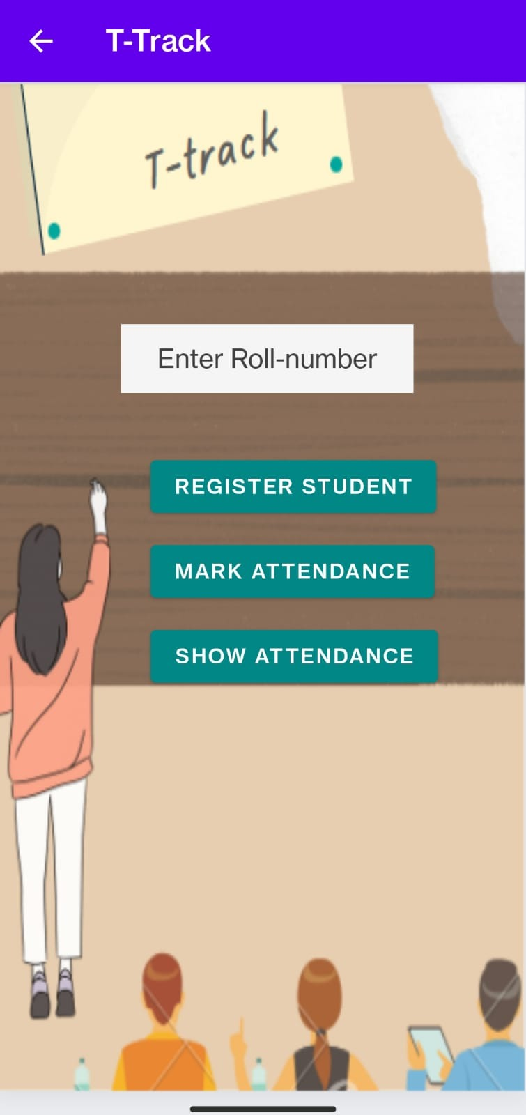
Working
Main Screen
After the class is selected the main screen is loaded which consists of options like :
Marking the attendance with the help of text written in “ENTER ROLL NUMBER” and pressing mark attendance button
If the name of student is present app marks its present and increases count by 1 else shows toast to register student
Show attendance is used to show the full attendance of the class

Slide 8
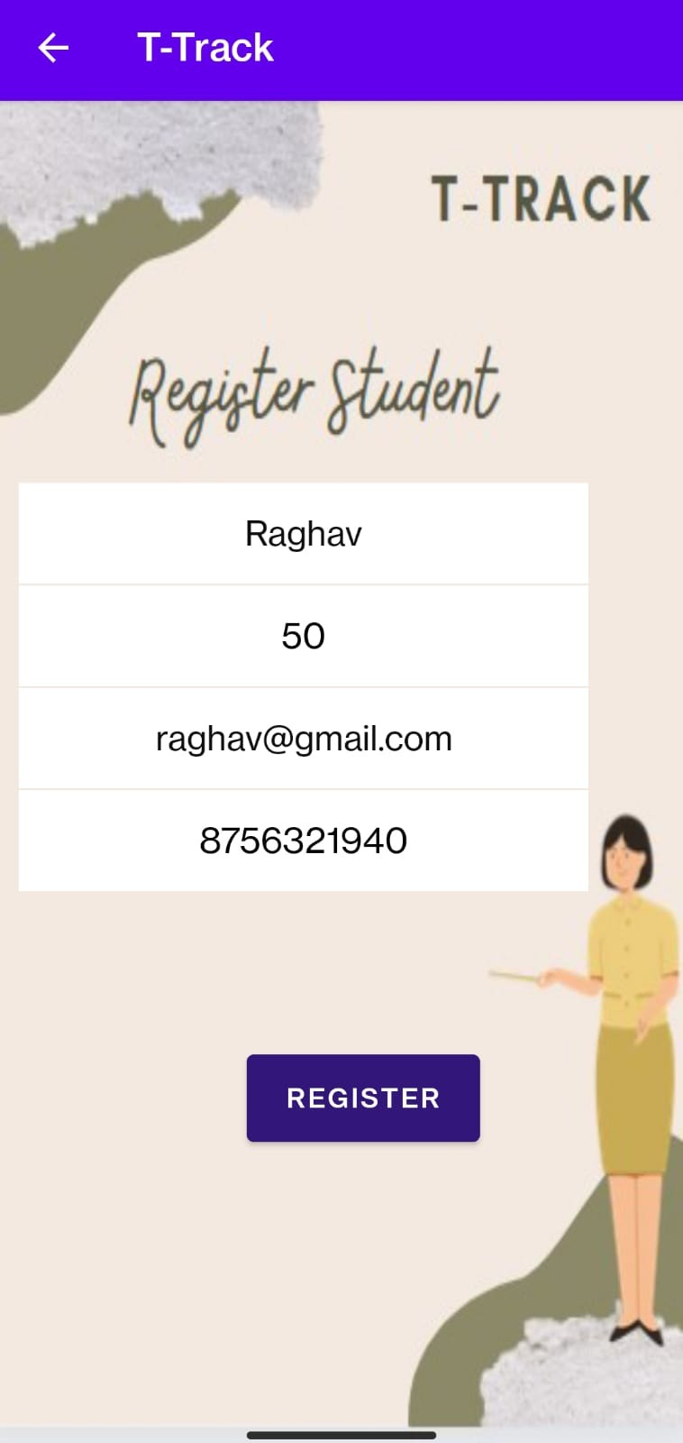
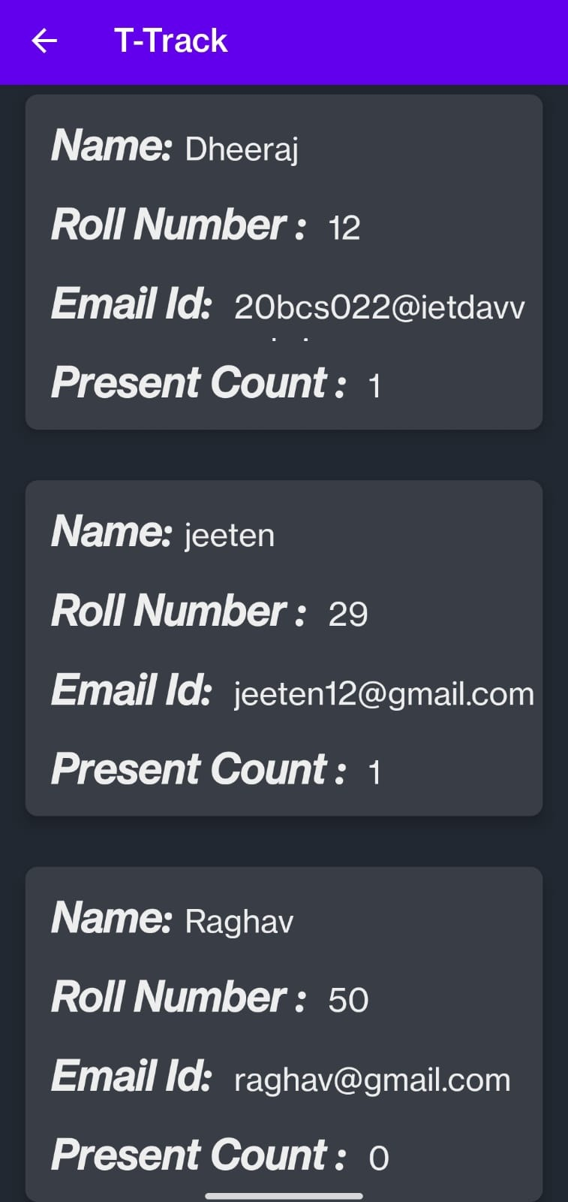
Working
Registering Student
Showing attendance
Registering the student by taking his/her name,roll number,email id, and Phone number.
Showing attendance of the student in form of a recyclerview

Slide 9
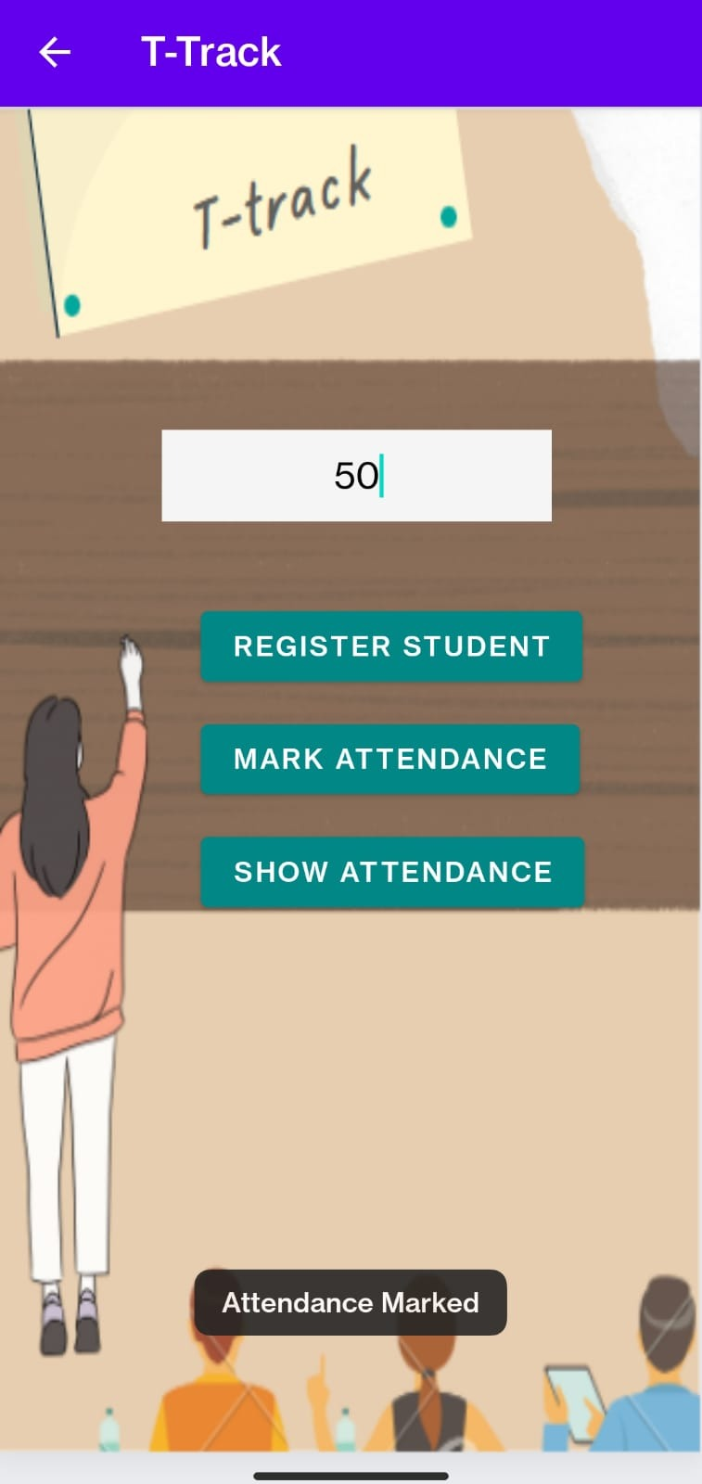
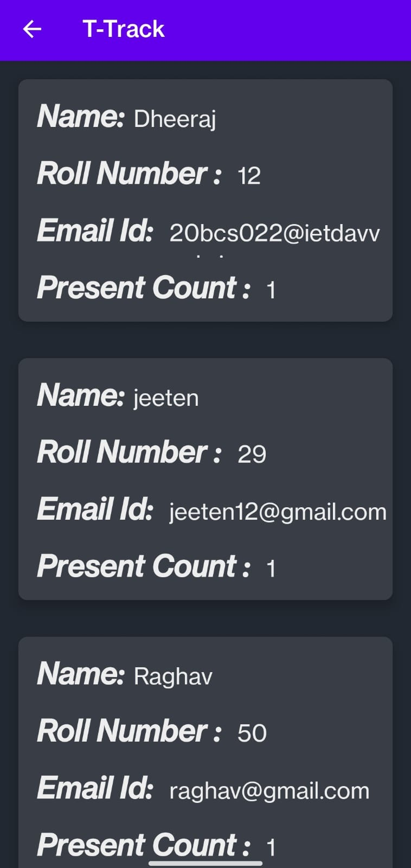
Working
Marking the attendance
Showing attendance
Now we could mark the attendance of the
student by entering his roll number in text view and pressing mark attendance button
Showing attendance of the student in form of a recyclerview
The present count is updated

Slide 10
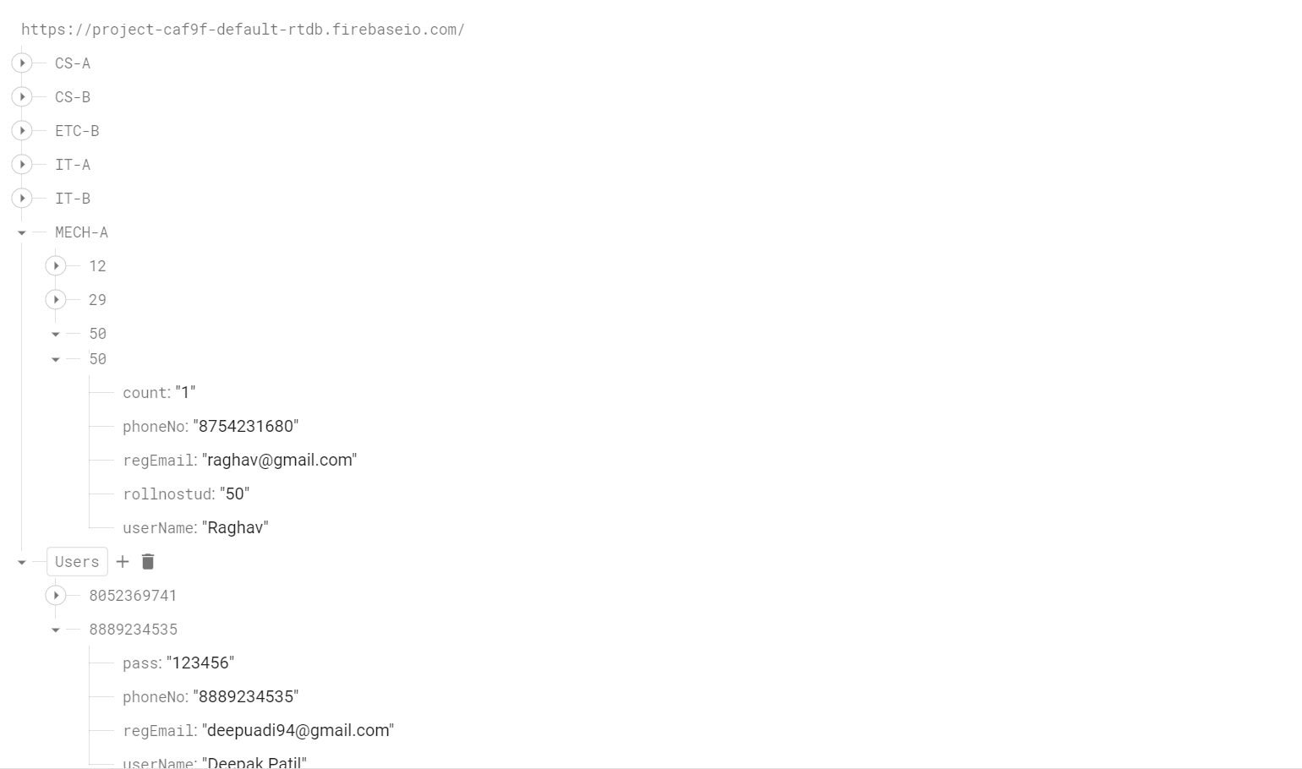

FireBase Console
The User section Consists of the id and password for login to app while the above sections of classes contain details of the students.

Slide 11


